Slide 1
19CSE431
DIGITAL IMAGE PROCESSING
POTHOLE DETECTION USING IMAGE PROCESSING TECHNIQUES
REVIEW - 2
AVANTIKA BALAJI - CB.EN.U4CSE20309
CHARITHA UPPALAPATI - CB.EN.U4CSE20311
KAUSALYAA SRI - CB.EN.U4CSE20326

Slide 2
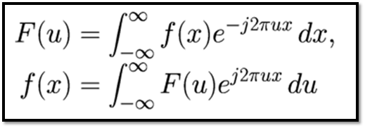
FEATURE EXTRACTION
Frequency Domain Filtering
We are using frequency filters to process the images in our dataset. Our image is first Fourier transformed, then multiplied by the filter function before being re-transformed into spatial domain. We obsserve that high frequency attenuation results in a smoother image in the spatial domain, while low frequency attenuation enhances the edges.
Fourier Transform
We implemented the following frequency domain filters and compared and contrasted them in order to choose the best one.

Slide 3
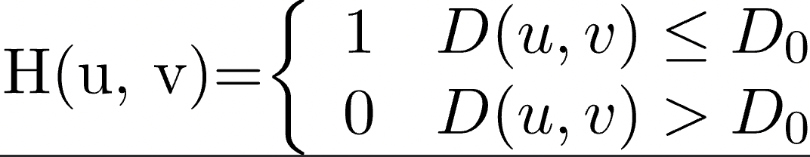
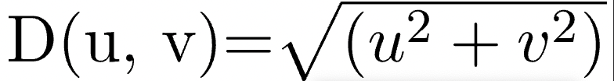
LOW PASS FILTERING - IMAGE SMOOTHING TECHNIQUES
It smoothes the image by reducing high frequency components while preserving low frequency components. The amount of strength reduced for each frequency depends on the design of the filter.
a) Ideal Low Pass Filter - It eliminates high-frequency noise from a digital image while retaining low-frequency components. The transfer function of ILPF of order n is defined as:
where
D0 is a positive constant
ILPF passes all the frequencies within a circle of radius D0 from the origin without attenuation and cuts off all the frequencies outside the circle.
Because D0 is the transition point between H(u, v) = 1 and H(u, v) = 0, it is referred to as the cutoff frequency.
D(u, v) is the Euclidean Distance from any point (u, v) to the frequency plane's origin:

Slide 4
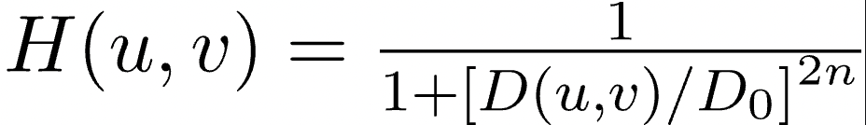
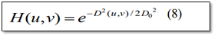
b) Butterworth Low Pass Filter - It removes high-frequency noise with very minimal loss of signal components. The transfer function of BLPF of order n is defined as:
c) Gaussian Low Pass Filter - It removes high frequency (sharp) features oriented along the X or Y axis. The practical result is a loss of detail or "blurring" effect on the image. The transfer function of Gaussian Lowpass filters is:

Slide 5
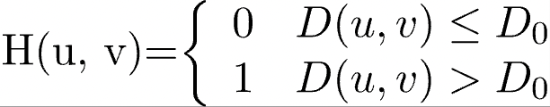
HIGH PASS FILTERING - IMAGE SHARPENING TECHNIQUES
A high pass filter tends to retain high frequency information while reducing low frequency information in an image. The high pass filter kernel is intended to increase the brightness of the centre pixel in comparison to neighbouring pixels.
a) Ideal High Pass Filter - it enhance the fine details and highlight the edges of potholes in the image. The transfer function of the IHPF can be specified by the function:

Slide 6
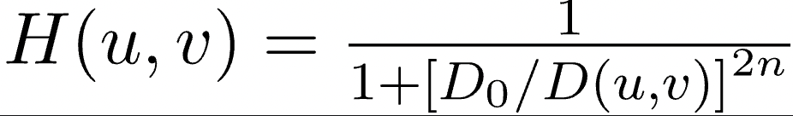
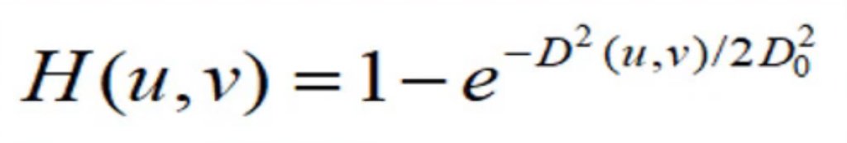
b) Butterworth High Pass Filter - It is the reverse operation of the Butterworth lowpass filter. The transfer function of BHPF of order n is defined as-
c) Gaussian High Pass Filter - It attenuates frequency components that are near to the image center (W/2, H/2). Transfer function of Gaussian High Pass Filter is given by:

Slide 7
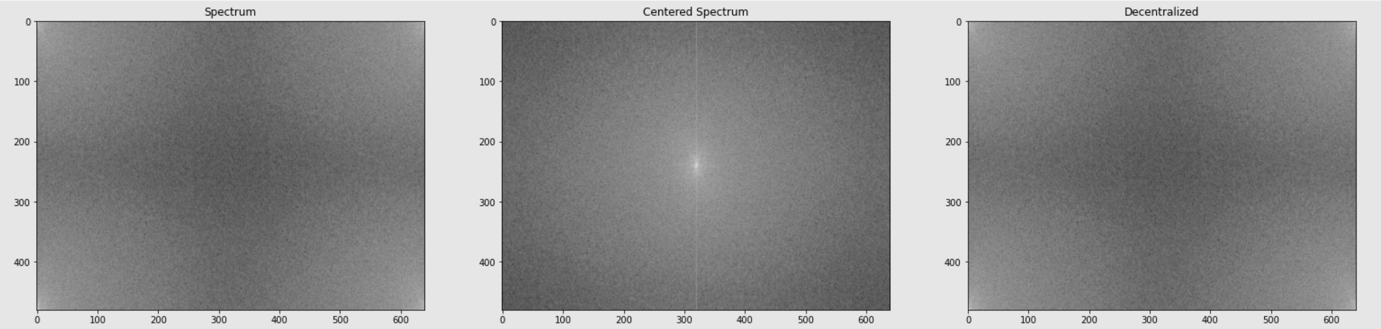
Phase Spectrum
The phase spectrum describes the phase of signal components as a function of frequency. Before passing filters and processing our image, we extract the phase spectrum from our original image and then get the centralised spectrum.

Slide 8
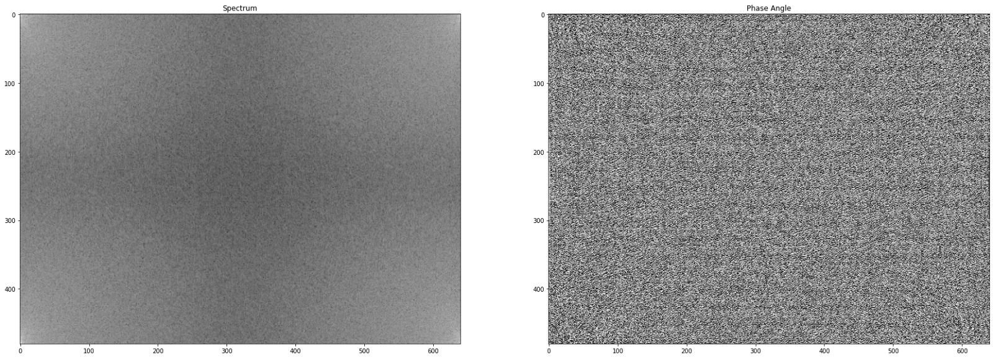
Phase Spectrum
The phase angle values determine the shift in the image's sinusoid components. With zero phase, all of the sinusoids are centred at the same point, resulting in a symmetric image whose structure bears no resemblance to the original image at all.

Slide 9
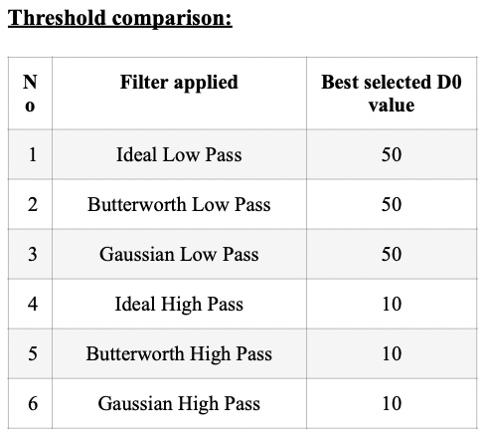
Thresholding
Following the implementation of each low pass and high pass filter with different threshold values (D0) ranging from sample multiples of 10: 10, 20, 30, 50, 100 for testing.

Slide 10
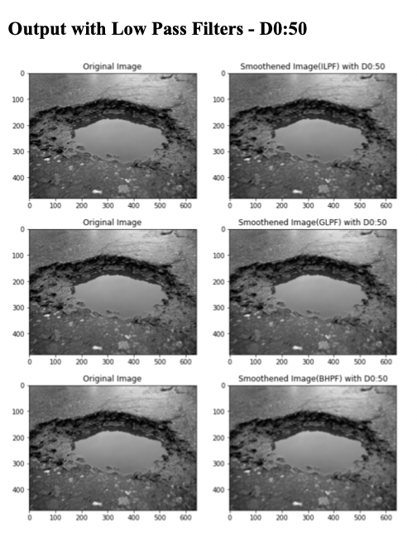
Summary Table
The table below summarises the best processed image obtained at the best fit threshold value for each filter used.

Slide 11
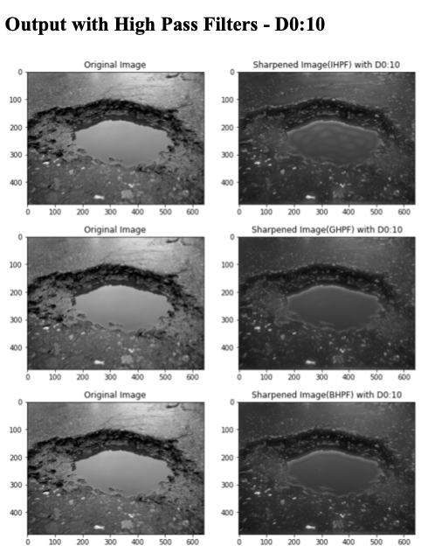
Summary Table

Slide 12
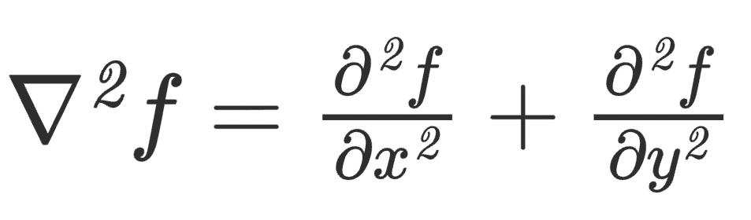
Edge Detection
a) Laplacian Filter - It emphasises areas of rapid intensity change and is an example of a second order or second derivative enhancement method. It excels at detecting the fine details of the pothole's edges. Any feature with a sharp discontinuity will benefit from a Laplacian operator.
The Laplacian is a well-known linear differential operator that approximates the second derivative, which is given by:
where f denotes the image

Slide 13
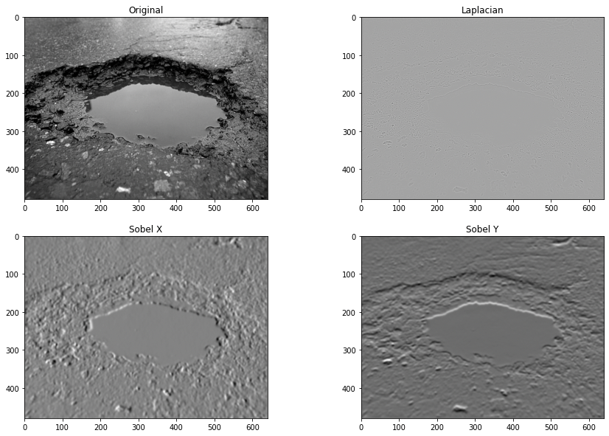
Edge Detection
b) Sobel Edge Detection - When Sobel Edge Detection is used, the image is processed separately in the X and Y directions before being combined to form a new image that represents the sum of the X and Y edges of the image. We first convert the image from RGB to Grayscale. Then we use a technique known as kernel convolution. A kernel is a 3 x 3 matrix made up of symmetrically (or differently) weighted indexes. This will be the filter that we will implement for edge detection.

Slide 14
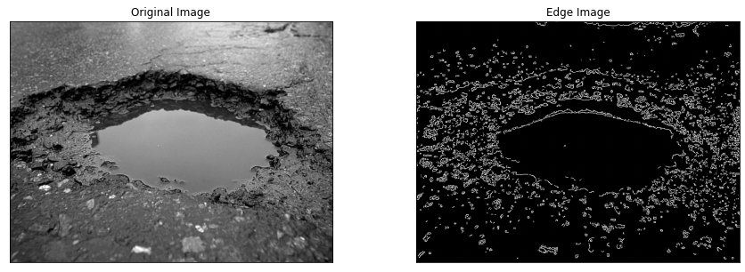
Edge Detection
c) Canny Edge Detection - It uses a multi-stage algorithm to detect a wide range of edges in images. We get a good detection: the pothole can be easily distinguished from the background because the optimal detector eliminates the possibility of false positives and false negatives. There is also the advantage of good localisation: the detected edges are as close to true edges as possible.

Slide 15
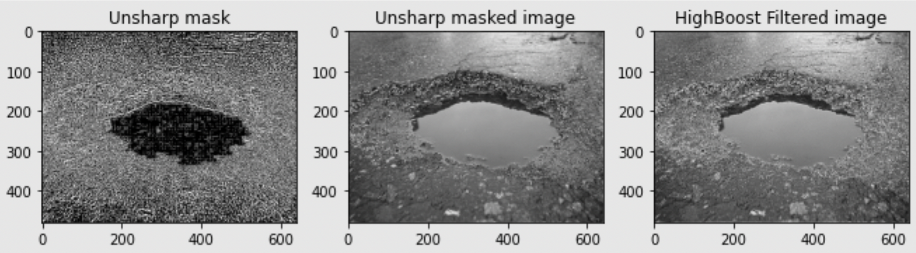
Edge Detection
d) Unsharp Masking and High Boost Filtering -
It enhances edges (and other high frequency components in an image) by subtracting an unsharpened, or smoothed, version of an image from the original image.

Slide 16
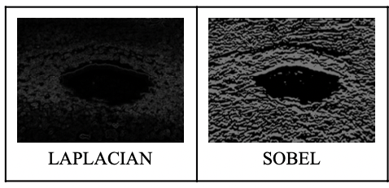
Laplacian VS Sobel Edge Detection
Between Laplacian and Sobel, we see that Sobel produces a better result. Unlike the Sobel edge detector, the Laplacian edge detector uses only one kernel. The Laplacian filter detects sudden intensity transitions in the image and highlights the edges. However, its main disadvantage is its high sensitivity to noise, which causes edges to spread with smoothing. It amplifies the noise in the image, as we observe, hence it is not the best filter when we have noisy images.

Slide 17
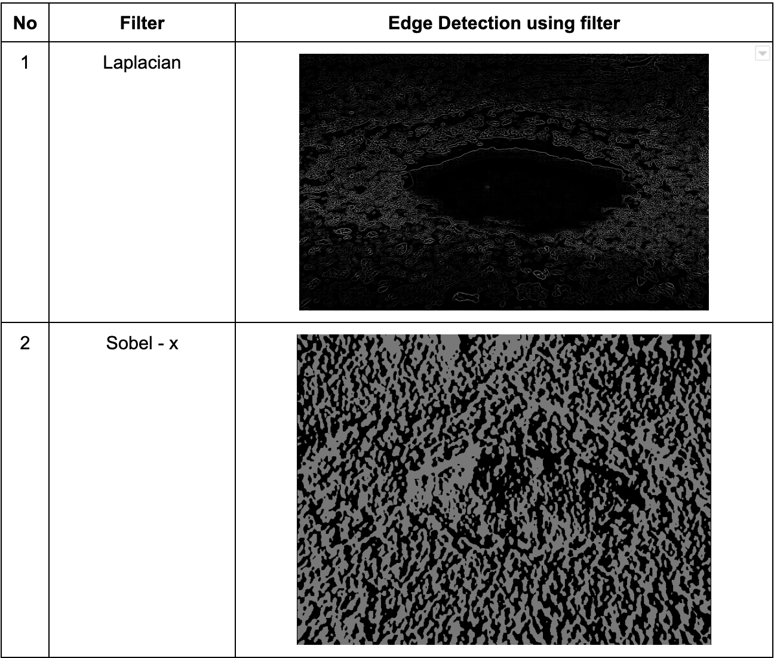
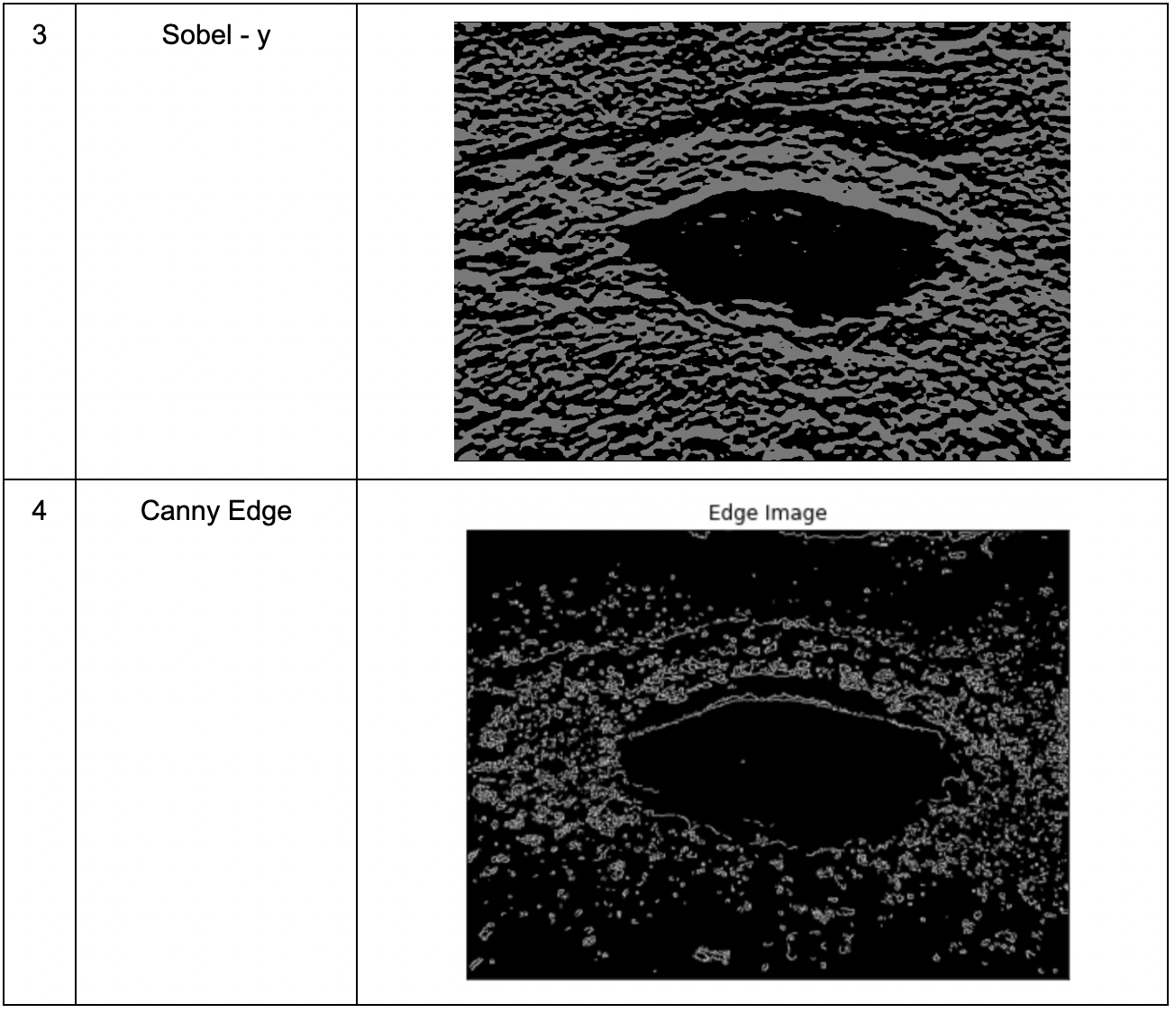
Edge Detection Table Summary
Here's a table that summarises the results of various edge detection filters.

Slide 18
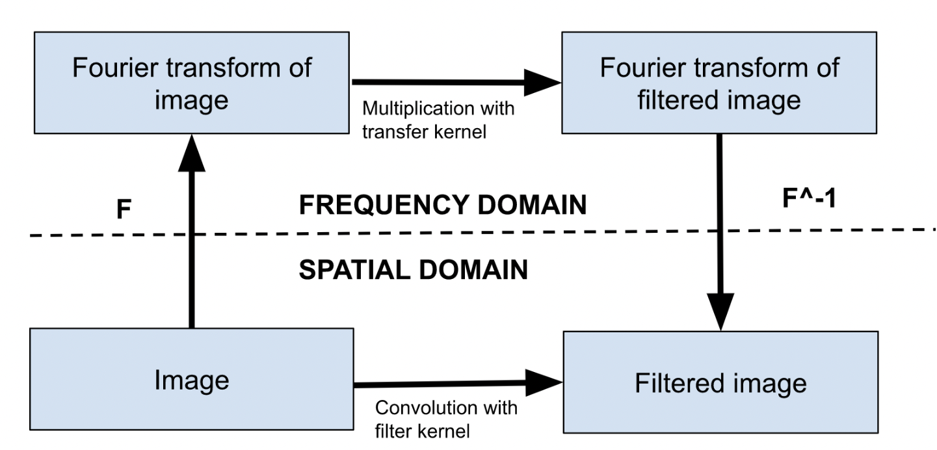
CATEGORIZATION
Frequency Domain VS Spatial Domain Filtering
Rather than filtering the image in the spatial domain by convolving it with the filter kernel, the image can be transformed into frequency space using the FFT (indicated by the symbol F). The image's Fourier transform is then multiplied by the filter function (also known as the transfer function, i.e., the convolution kernel's Fourier transform), and the resulting frequency-space filtered image is subjected to the inverse Fourier transform (F^-1). Although this "detour" into the frequency domain appears to be extra work, the overall computational cost is significantly lower than that of a convolution with large kernel sizes.

Slide 19
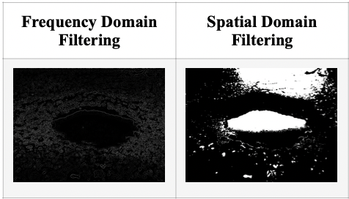
Frequency Domain VS Spatial Domain Filtering
This is especially true as the filter size increases. While spatial filters are commonly used for edge detection, frequency filters are used for high frequency emphasis. In this case, the filter does not completely block low frequencies, but rather magnifies high frequencies in comparison to low frequencies, thus projecting the potholes more clearly. We see that frequency domain filtering produces a much better filtered output than spatial domain filtering.

Slide 20
NOISE
Image noise is the random variation of brightness or colour information in captured images. It could be caused by external sources such as wind, rain, ordust settling on the lens of the camera mounted on the vehicle, which degrades the image signal. Noise is created in the image during the acquisition process or is added to the image during transmission over a wired or wireless medium.
We explored some of the following noise models:
1. Spatially independent noise models
• Gaussian noise
• Speckle
• Uniform noise
• Impulse (salt-and-pepper) noise • Rayleigh noise
• Erlang (Gamma) noise • Exponential noise
2. Spatially dependent noise model
• Periodic noise

Slide 21
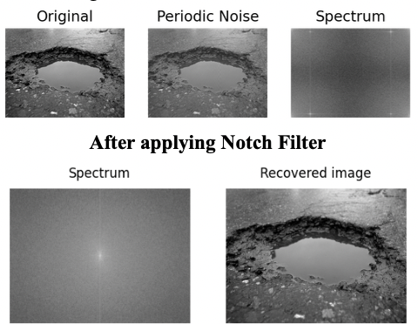
Noise Models
1. Periodic Noise - We see that it creates strips in an order on an image in the spatial domain. It interferes with our original image with the pothole at a random frequency. We are using a notch filter to remove this noise. Since it is a band reject filter, it rejects the specific circular bands of frequencies around the frequency domain image's centre because frequency domain images are symmetric about opposite quadrants. It helps reject not only the central noisy peak but also the noisy frequency areas corresponding to noisy spikes. Our recovered image has removed the noise and is slightly better than the original.

Slide 22
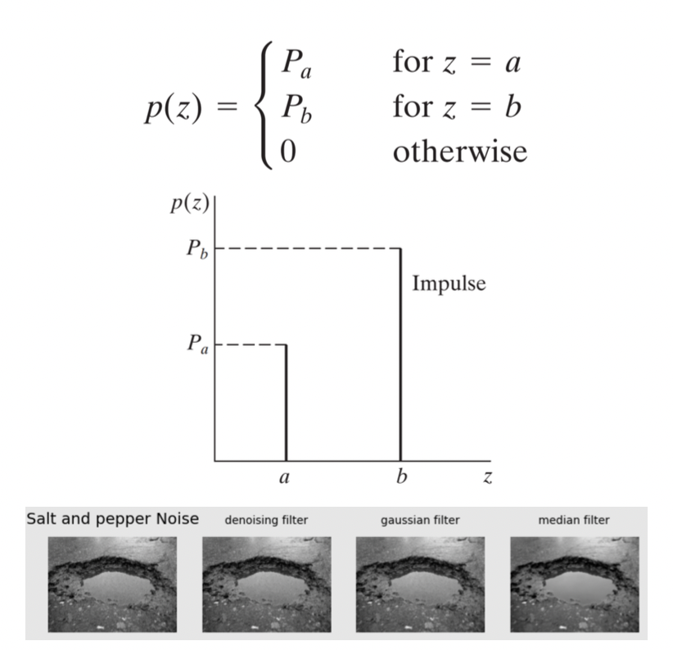
Noise Models
2. Salt and Pepper Noise - We add salt and pepper noise to an image by randomly scattering bright (255 pixel value) and dark (0 pixel value) pixels across it. Since it statistically drops the original data values, this model is also known as data drop noise. We apply denoising, gaussian and median filter to this noisy image and compare which gives us the best result.

Slide 23
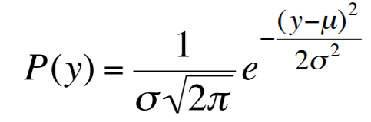
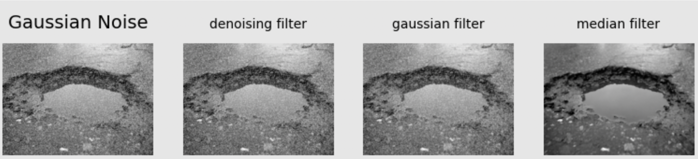
Noise Models
3. Gaussian Noise - We use the Gaussian probability distribution function to generate Gaussian noise on images. Our Gaussian probability distribution function is represented by the formula below.
Here’s the result on applying the respective filters.

Slide 24
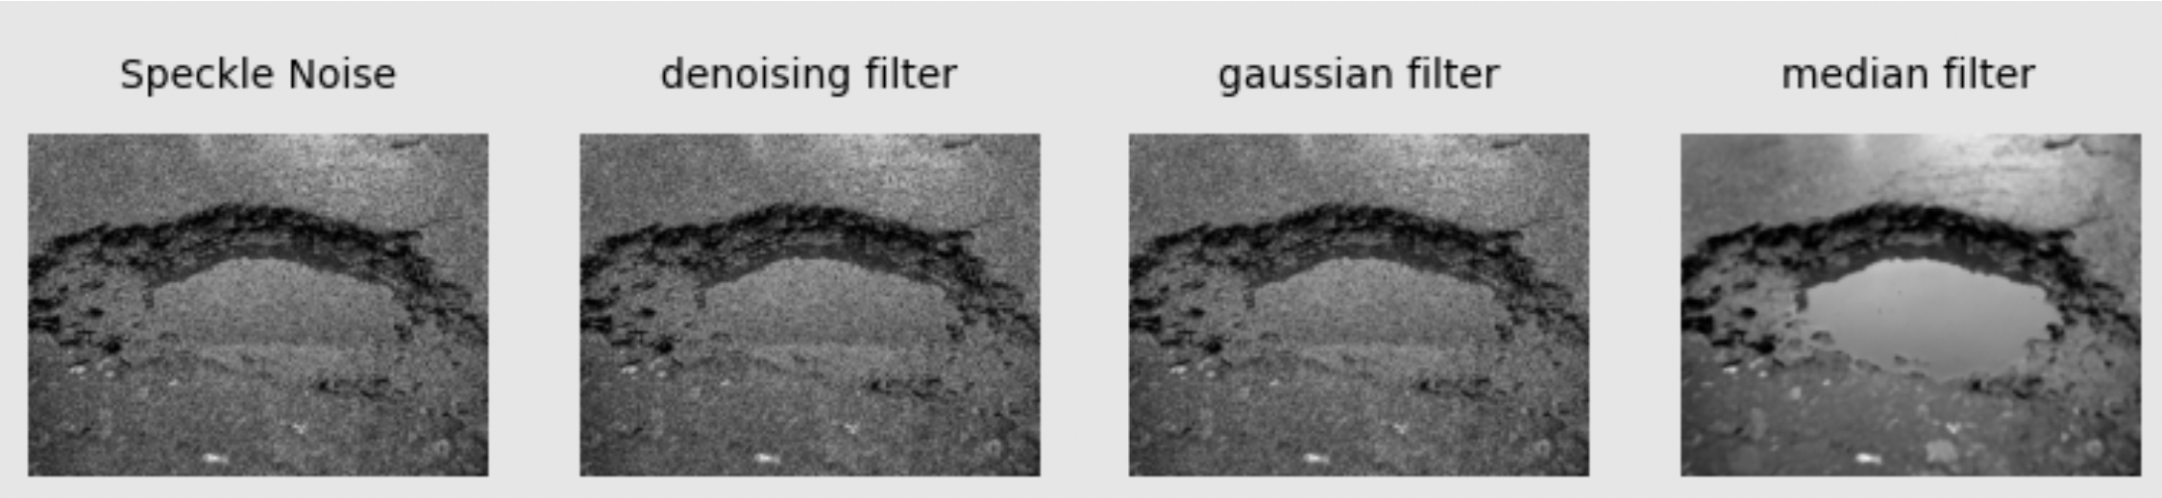
Noise Models
4. Speckle Noise - It is the granular noise seen in our images that exists inherently and degrades their quality. Speckle noise can be created by multiplying random pixel values by different image pixels.

Slide 25
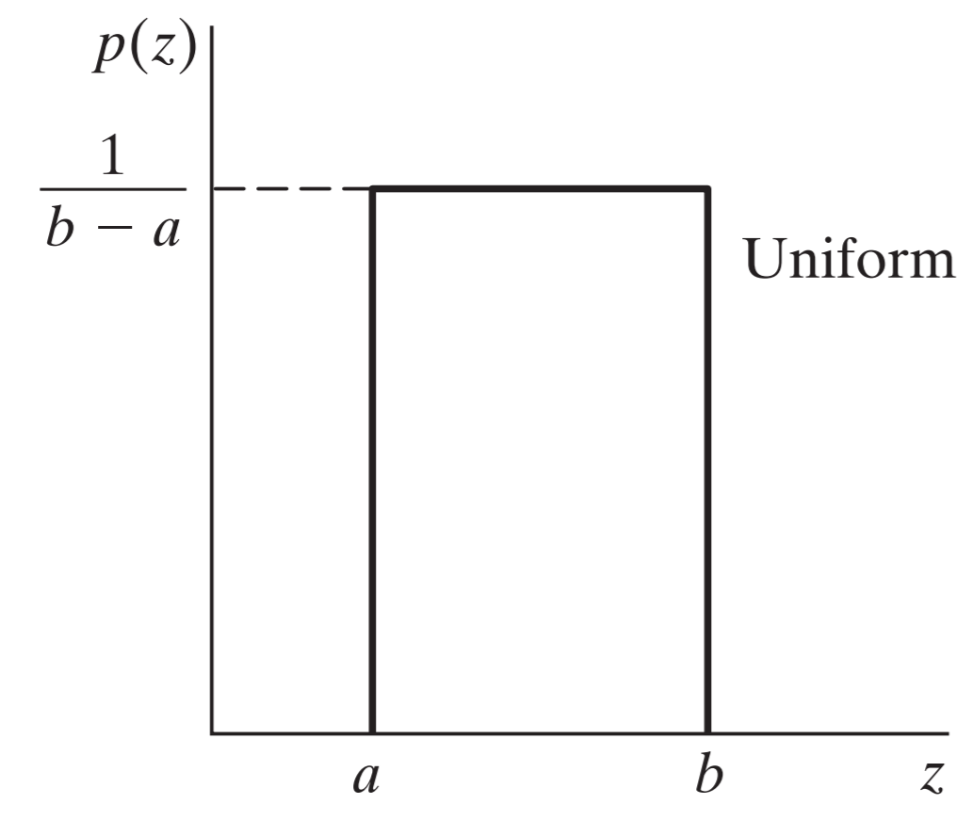
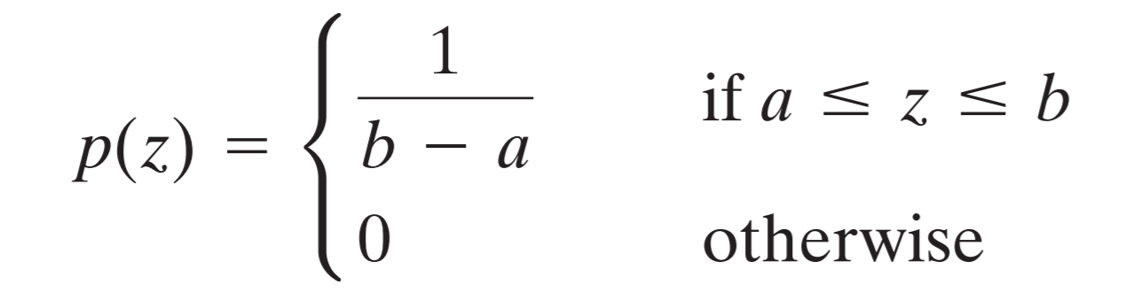
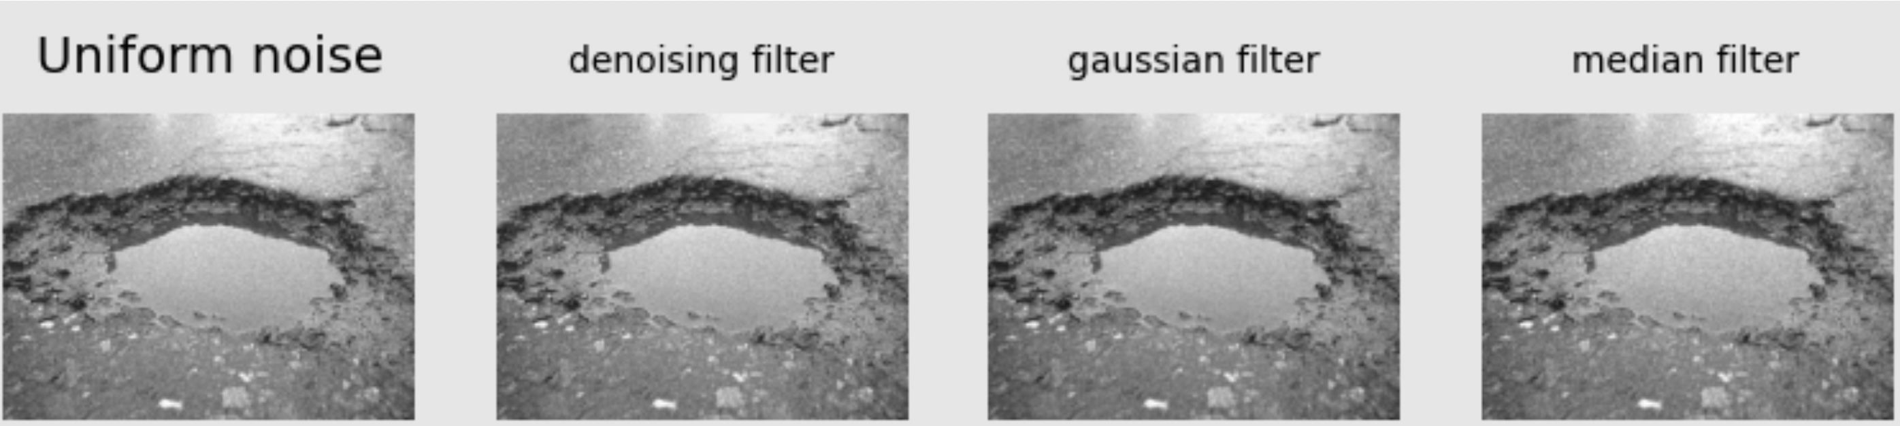
Noise Models
5. Uniform Noise - Quantization noise is the uniform noise caused by quantizing the pixels of an image to a number of distinct levels. This noise is frequently used to degrade images in order to evaluate image restoration algorithms.Permutation of a probability distribution function to distribute noise pixel intensity values:
Parameters a and b are essentially the intensity boundaries between which we distribute uniform noise PDF.

Slide 26
De-Noising Models
1. Notch Filter -
It is a narrow band reject filter used to remove a single frequency or a narrow band of frequencies. Notch filters can be created from a combination of high-pass and low-pass filters. This filter rejects frequencies in specific neighbourhoods surrounding a centre frequency. The power spectrum densification of an image is used to detect noise spikes visually.

Slide 27
De-Noising Models
2. Median Filter -
The median filter examines each pixel in the image individually and compares it to its neighbours to determine whether or not it is representative of its surroundings. It replaces the pixel value with the median of neighbouring pixel values rather than the mean of those values.

Slide 28
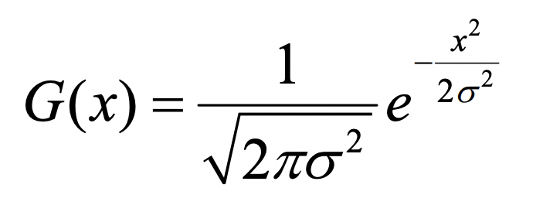
De-Noising Models
3. Gaussian Filter -
Gaussian filtering, g, is used to blur images and remove noise and detail. In one dimension, the Gaussian function is:

Slide 29
De-Noising Models
4. Non Local Means Denoising Filter -
The non- local means algorithm replaces a pixel's value with an average of the values of a subset of other pixels: small patches centered on the other pixels are compared to the patch centered on the pixel of interest, and the average is performed only for pixels with patches close to the current patch. As a result, this algorithm can effectively restore textures that would otherwise be blurred by other denoising algorithms.

Slide 30
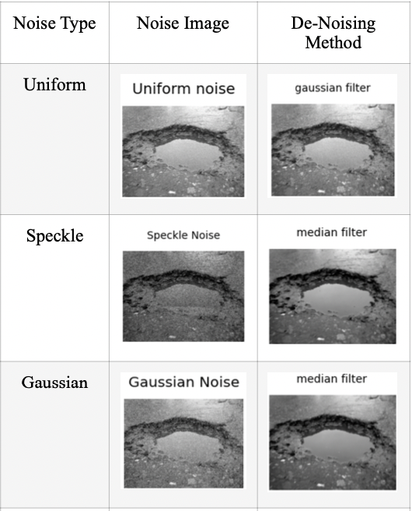
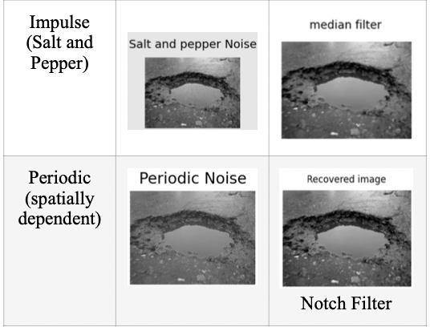
De-Noising Model Summary Table
Conclusion of the best de-noising method used to remove the noise in each noise model

Slide 31
Thank You

